Slide 1
Virtual Memory

Slide 2
Goals for Today
Virtual memory
Mechanism
How does it work?
Policy
What to replace?
How much to fetch?

Slide 3
What is virtual memory?
Each process has illusion of large address space
2³² for 32-bit addressing
However, physical memory is much smaller
How do we give this illusion to multiple processes?
Virtual Memory: some addresses reside in disk
page 0
disk
page 1
page table
page 2
page 3
page 4
page N
Physical memory
Virtual memory

Slide 4
Virtual memory
Separates users logical memory from physical memory.
Only part of the program needs to be in memory for execution
Logical address space can therefore be much larger than physical address space
Allows address spaces to be shared by several processes
Allows for more efficient process creation

Slide 5
Swapping vs Paging
Swapping
Loads entire process in memory , runs it, exit
Is slow (for big, long-lived processes)
Wasteful (might not require everything)
Paging
Runs all processes concurrently, taking only pieces of memory (specifically, pages) away from each process
Finer granularity, higher performance
Paging completes separation between logical memory and physical memory – large virtual memory can be provided on a smaller physical memory
The verb “to swap” is also used to refer to pushing contents of a page out to disk in order to bring other content from disk; this is distinct from the noun “swapping”

Slide 6
How does VM work?
Modify Page Tables with another bit (“is present”)
If page in memory, is_present = 1, else is_present = 0
If page is in memory, translation works as before
If page is not in memory, translation causes a page fault
0
1
2
3
32 :P=1
4183 :P=0
177 :P=1
5721 :P=0
Disk
Mem
Page Table

Slide 7
Page Faults
On a page fault:
OS finds a free frame, or evicts one from memory (which one?)
Want knowledge of the future?
Issues disk request to fetch data for page (what to fetch?)
Just the requested page, or more?
Block current process, context switch to new process (how?)
Process might be executing an instruction
When disk completes, set present bit to 1, and current process in ready queue

Slide 8
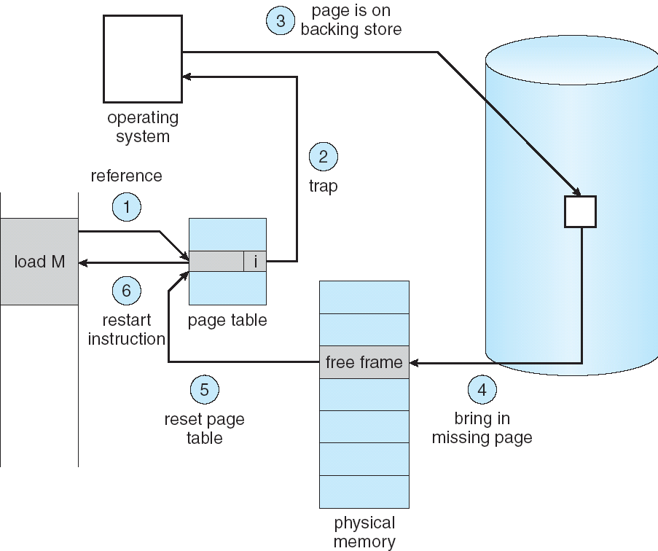
Steps in Handling a Page Fault

Slide 9
What to replace?
What happens if there is no free frame?
find a suitable page in memory, swap it out
Page Replacement
When process has used up all frames it is allowed to use
OS must select a page to eject from memory to allow new page
The page to eject is selected using the Page Replacement Algo
Goal: Select page that minimizes future page faults

Slide 10
Modified/Dirty Bits
Use modify (dirty) bit to reduce overhead of page transfers – only modified pages are written to disk, non-modified pages can always be brought back from the original source
Process text segments are rarely modified, can bring pages back from the program image stored on disk

Slide 11
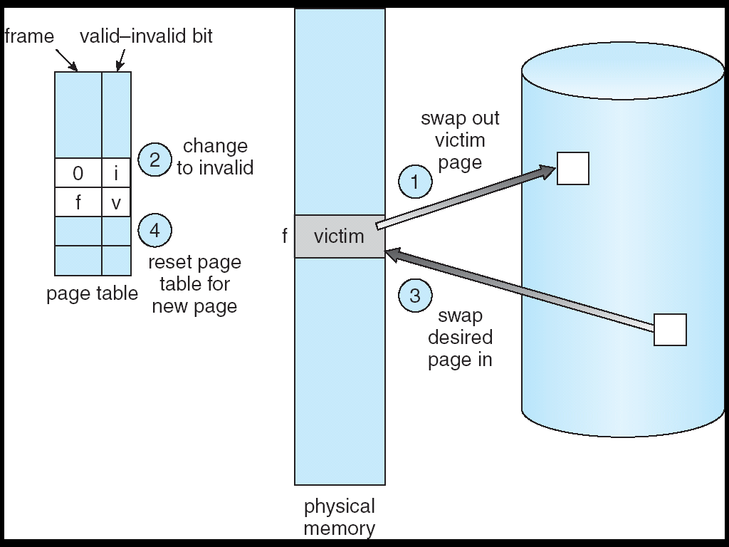
Page Replacement

Slide 12
Page Replacement Algorithms
Random: Pick any page to eject at random
Used mainly for comparison
FIFO: The page brought in earliest is evicted
Ignores usage
OPT: Belady’s algorithm
Select page not used for longest time
LRU: Evict page that hasn’t been used the longest
Past could be a good predictor of the future
MRU: Evict the most recently used page
LFU: Evict least frequently used page

Slide 13
First-In-First-Out (FIFO) Algorithm
Reference string: 1, 2, 3, 4, 1, 2, 5, 1, 2, 3, 4, 5
3 frames (3 pages can be in memory at a time per process): 1, 2, 3, 4, 1, 2, 5, 1, 2, 3, 4, 5
4 frames: 1, 2, 3, 4, 1, 2, 5, 1, 2, 3, 4, 5
Belady’s Anomaly: more frames ⇒ more page faults
1
1
4
5
2
2
1
3
9 page faults
3
3
2
4
1
1
5
4
2
2
1
5
10 page faults
3
3
2
4
4
3

Slide 14
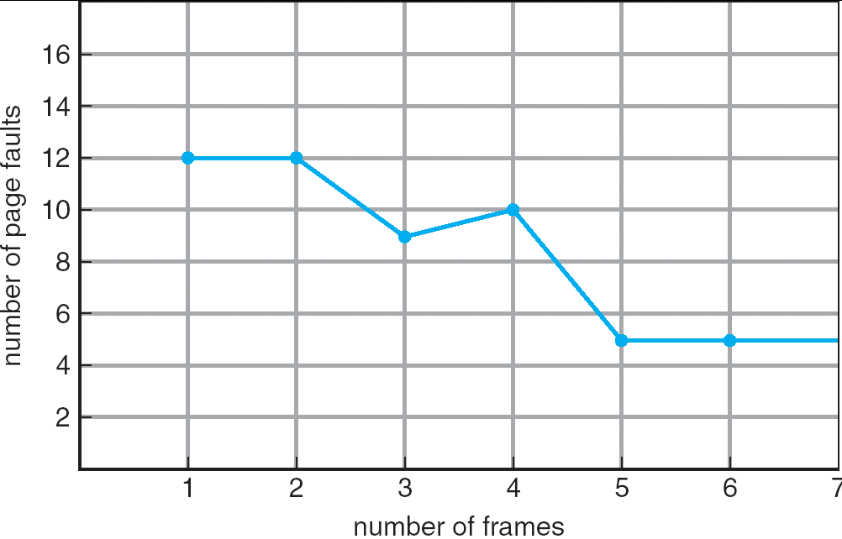
FIFO Illustrating Belady’s Anomaly

Slide 15
Optimal Algorithm
Replace page that will not be used for longest period of time
4 frames example
1, 2, 3, 4, 1, 2, 5, 1, 2, 3, 4, 5
How do you know this?
Used for measuring how well your algorithm performs
1
4
2
6 page faults
3
4
5

Slide 16
Example: FIFO, OPT
Reference stream is A B C A B D A D B C
OPTIMAL
A B C A B D A D B C B
5 Faults
toss C
toss A or D
A
B
C
D
A
B
C
FIFO
A B C A B D A D B C B
7 Faults
toss A
toss ?

Slide 17
OPT Approximation
In real life, we do not have access to the future page request stream of a program
No crystal ball, no way to know definitively which pages a program will access
So we need to make a best guess at which pages will not be used for the longest time

Slide 18
Least Recently Used (LRU) Algorithm
Reference string: 1, 2, 3, 4, 1, 2, 5, 1, 2, 3, 4, 5
Counter implementation
Every page entry has a counter; every time page is referenced through this entry, copy the clock into the counter
When a page needs to be changed, look at the counters to determine which are to change
1
1
1
1
5
2
2
2
2
2
3
5
5
4
4
4
4
3
3
3

Slide 19
Implementing Perfect LRU
On reference: Time stamp each page
On eviction: Scan for oldest frame
Problems:
Large page lists
Timestamps are costly
Approximate LRU
LRU is already an approximation!
13
t=4
t=14
t=14
t=5
0xffdcd: add r1,r2,r3
0xffdd0: ld r1, 0(sp)
14
14

Slide 20
LRU: Clock Algorithm
Each page has a reference bit
Set on use, reset periodically by the OS
Algorithm:
FIFO + reference bit (keep pages in circular list)
Scan: if ref bit is 1, set to 0, and proceed. If ref bit is 0, stop and evict.
Problem:
Low accuracy for large memory
R=1
R=1
R=0
R=0
R=1
R=0
R=1
R=1
R=0
R=1
R=0

Slide 21
LRU with large memory
Solution: Add another hand
Leading edge clears ref bits
Trailing edge evicts pages with ref bit 0
What if angle small?
What if angle big?
Sensitive to sweeping interval and angle
Fast: lose usage information
Slow: all pages look used
R=1
R=1
R=0
R=0
R=1
R=0
R=1
R=1
R=0
R=1
R=0

Slide 22
Other Algorithms
MRU: Remove the most recently touched page
Works well for data accessed only once, e.g. a movie file
Not a good fit for most other data, e.g. frequently accessed items
LFU: Remove page with lowest count
No track of when the page was referenced
Use multiple bits. Shift right by 1 at regular intervals.
MFU: remove the most frequently used page
LFU and MFU do not approximate OPT well

Slide 23
Allocating Pages to Processes
Global replacement
Single memory pool for entire system
On page fault, evict oldest page in the system
Problem: lack of performance isolation
Local (per-process) replacement
Have a separate pool of pages for each process
Page fault in one process can only replace pages from its own process
Problem: might have idle resources

Slide 24
Thrashing
Def: Excessive rate of paging
May stem from lack of resources
More likely, caused by bad choices of the eviction algorithm
Keep throwing out page that will be referenced soon
So, they keep accessing memory that is not there
Why does it occur?
Poor locality, past != future
There is reuse, but process does not fit model
Too many processes in the system

Slide 25
Working Set
Peter Denning, 1968
He uses this term to denote memory locality of a program
Def: pages referenced by process in last Δ time-units comprise its working set
For our examples, we usually discuss WS in terms of Δ, a “window” in the page reference string. But while this is easier on paper it makes less sense in practice!
In real systems, the window should probably be a period of time, perhaps a second or two.

Slide 26
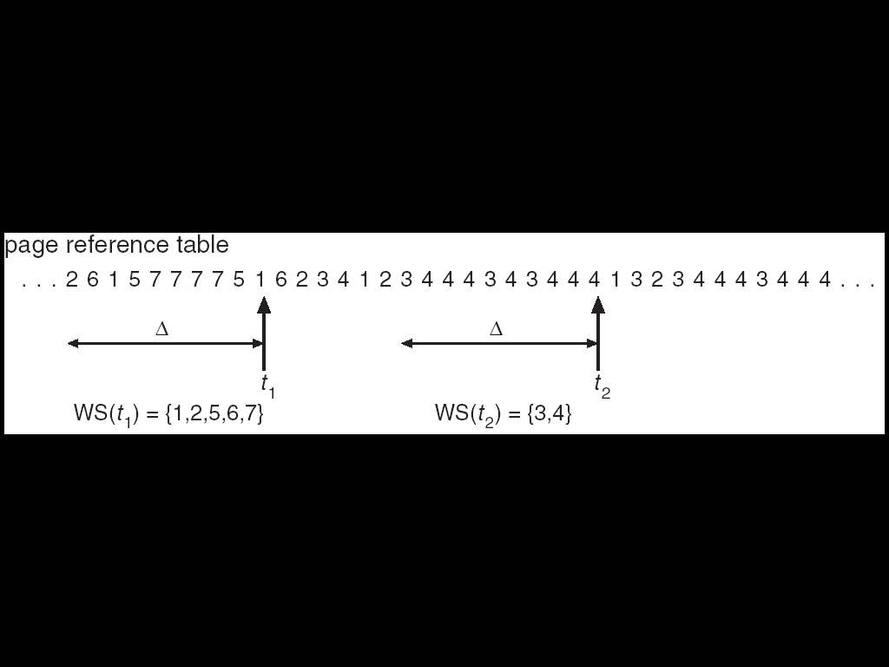
Working Sets
The working set size is num pages in the working set
the number of pages touched in the interval [t-Δ+1..t].
The working set size changes with program locality.
during periods of poor locality, you reference more pages.
Within that period of time, you will have a larger working set size.
Goal: keep WS for each process in memory.
E.g. If Σ WS_{i} for all i runnable processes > physical memory, then suspend a process

Slide 27
Working Set Approximation
Approximate with interval timer + a reference bit
Example: Δ = 10,000
Timer interrupts after every 5000 time units
Keep in memory 2 bits for each page
Whenever a timer interrupts copy and sets the values of all reference bits to 0
If one of the bits in memory = 1 ⇒ page in working set
Why is this not completely accurate?
Cannot tell (within interval of 5000) where reference occured
Improvement = 10 bits and interrupt every 1000 time units

Slide 28
Using the Working Set
Used mainly for prepaging
Pages in working set are a good approximation
In Windows processes have a max and min WS size
At least min pages of the process are in memory
If > max pages in memory, on page fault a page is replaced
Else if memory is available, then WS is increased on page fault
The max WS can be specified by the application
Notes:
The max is also modified then window is minimized!
Let’s see the task manager

Slide 29
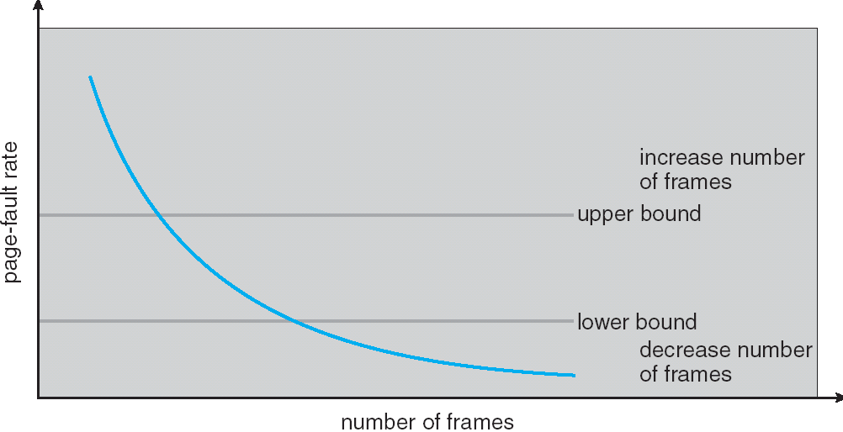
Page Fault Frequency
Thrashing viewed as poor ratio of fetch to work
PFF = page faults / instructions executed
if PFF rises above threshold, process needs more memory
not enough memory on the system? Swap out.
if PFF sinks below threshold, memory can be taken away

Slide 30
Working Sets and Page Fault Rates
Working set
Page fault rate
transition
stable

Slide 31
OS and Paging
Process Creation:
Allocate space and initialize page table for program and data
Allocate and initialize swap area
Info about PT and swap space is recorded in process table
Process Execution
Reset MMU for new process
Flush the TLB
Bring processes’ pages in memory
Page Faults
Process Termination
Release pages

